Slide 1
Lab 1 Text Preprocesing using Python
Lê Anh Cường

Slide 2
Text preprocessing
Texts
Sentences
Word docs
Reader
Multi Sources
Text
Preprocessing
Tokens
.cvs
Reader
Number, date, capital words,..
Crawler
Html
Reader

Slide 3
texts
Tokenizer
Morphology analysis
POS tagging
Parsing
(Syntactic analysis)
Semantic Analysis
Pragmatic Analysis
Results

Slide 4
Content
Data reading
Regular expression
Tokenizer
Statistics on texts

Slide 5
Data Reading
Text file
Pandas library for reading structured files
Cvs files
Word files
Html files

Slide 6
Regular Expression
In 1951, mathematician Stephen Cole Kleene described the concept of a regular language, a language that is recognizable by a finite automaton and formally expressible using regular expressions. In the mid-1960s, computer science pioneer Ken Thompson, one of the original designers of Unix, implemented pattern matching in the QED text editor using Kleene’s notation.
Since then, regexes have appeared in many programming languages, editors, and other tools as a means of determining whether a string matches a specified pattern. Python, Java, and Perl all support regex functionality, as do most Unix tools and many text editors.

Slide 7
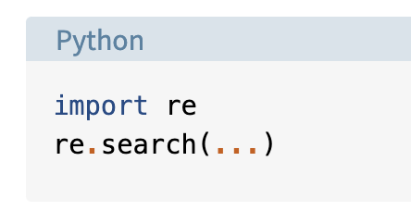
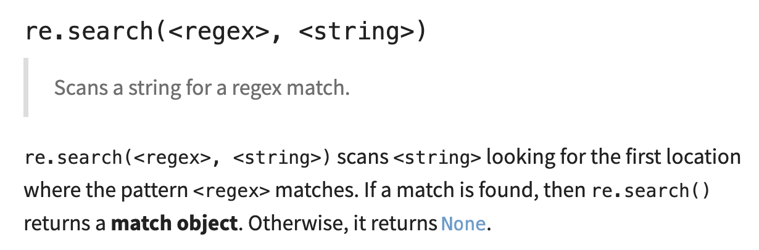
The re Module
Regex functionality in Python resides in a module named re. The re module contains many useful functions and methods

Slide 8
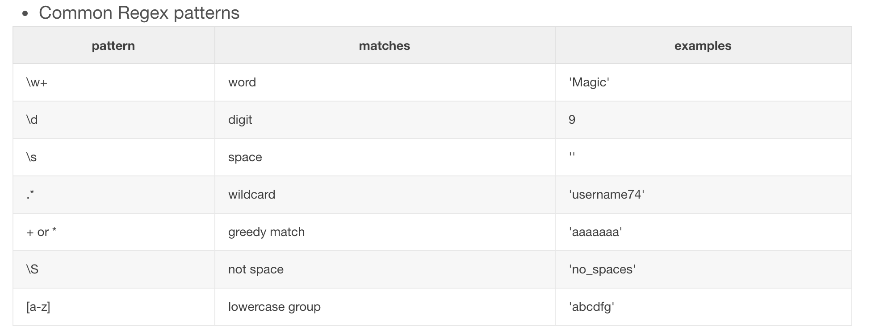
Common Regex Patterns

Slide 9
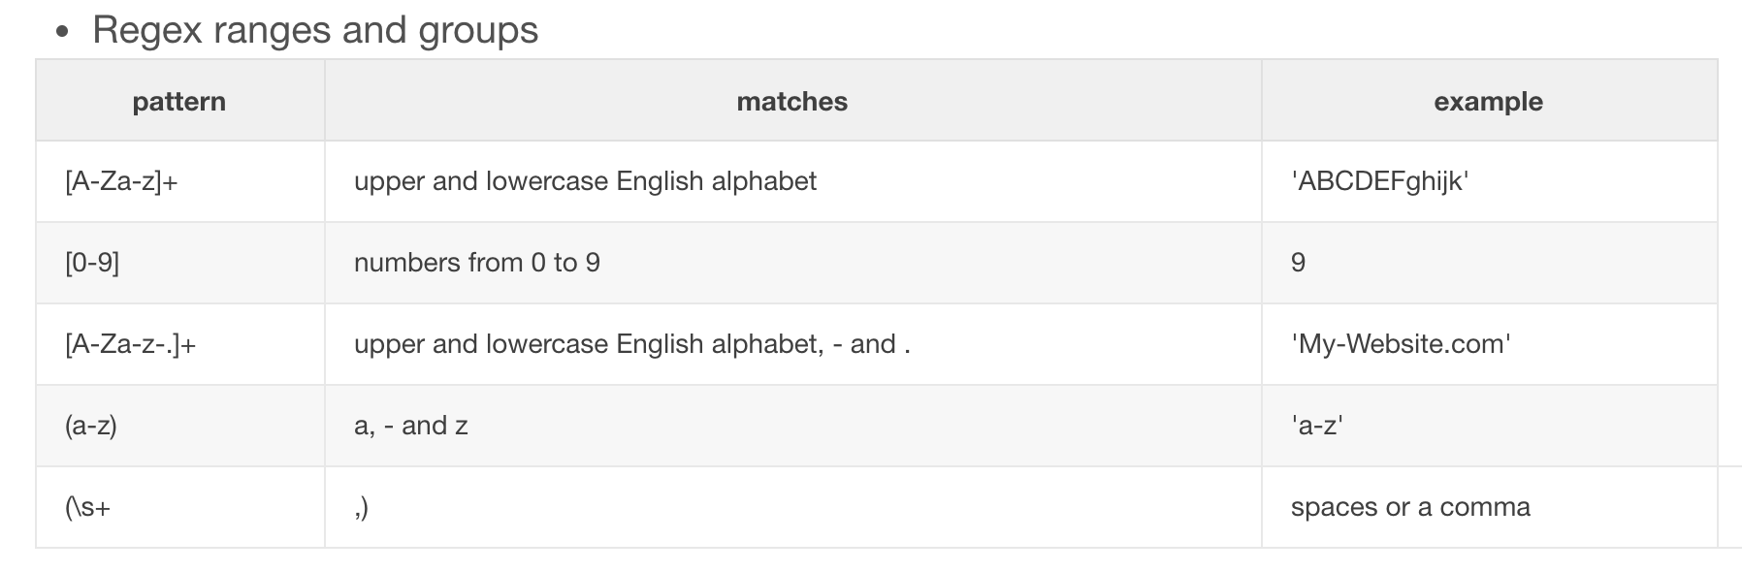

Slide 11
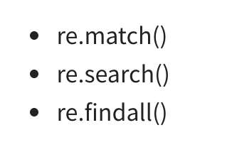
Using regular expression methods
findall() module is used to search for “all” occurrences that match a given pattern. In contrast, s
search() module will only return the first occurrence that matches the specified pattern.
Note that re.match matches from the beginning of the string.

Slide 12
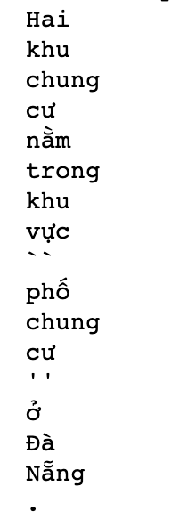
Tokenize
Input = “Hai khu chung cư nằm trong khu vực "phố chung cư" ở Đà Nẵng. Các ca dương tính ghi nhận tại đây gồm "bệnh nhân 849, 853, 780, 781, 797 và 802". Từ 25/7 đến nay, Đà Nẵng đã ghi nhận 296 người mắc nCoV. Thành phố đang tiếp tục áp dụng cách ly xã hội theo chỉ thỉ 16 để khoanh vùng, dập dịch.”
#1 Hai khu chung cư nằm trong khu vực "phố chung cư" ở Đà Nẵng.
#2 Các ca dương tính ghi nhận tại đây gồm "bệnh nhân 849, 853, 780, 781, 797 và 802".
#3 Từ 25/7 đến nay, Đà Nẵng đã ghi nhận 296 người mắc nCoV.
#4 Thành phố đang tiếp tục áp dụng cách ly xã hội theo chỉ thỉ 16 để khoanh vùng, dập dịch.

Slide 13
Practice
https://www.w3resource.com/python-exercises/re/

Slide 14
References
https://www.tutorialspoint.com/python/python_reg_expressions.htm
https://www.w3schools.com/python/python_regex.asp
https://docs.python.org/3/howto/regex.html
https://www.datacamp.com/community/tutorials/python-regular-expression-tutorial

Slide 15
Exercises
Write a program for sentence splitter and token splitter, using regular expression.
Write functions to check whether a token/word has form of website, date, number, float, containing mix of characters and decimals, containing characters only.
Do statistics on tokens from a given text: list different tokens and their frequency.

